Slide 1



Predicting apartments prices
Regression Project, Machine Learning I
Cezary Kuźmowicz, 473169
Wojciech Hrycenko, 473173

Slide 2
TABLE OF CONTENTS
01
02
03
04
05
Introduction
Exploratory Data Analysis
Feature Engineering
Modelling
Predictions

Slide 3


INTRODUCTION
Main goal was to apply various ML algorithms to build a model explaining the prices of apartments based on the training sample and generate predictions for all observations from the test sample.

Slide 4
PROJECT PROCESS
Feature Engineering
Predictions
EDA
Modelling

Slide 5

01
EXPLORATORY DATA ANALYSIS (EDA)

Slide 6
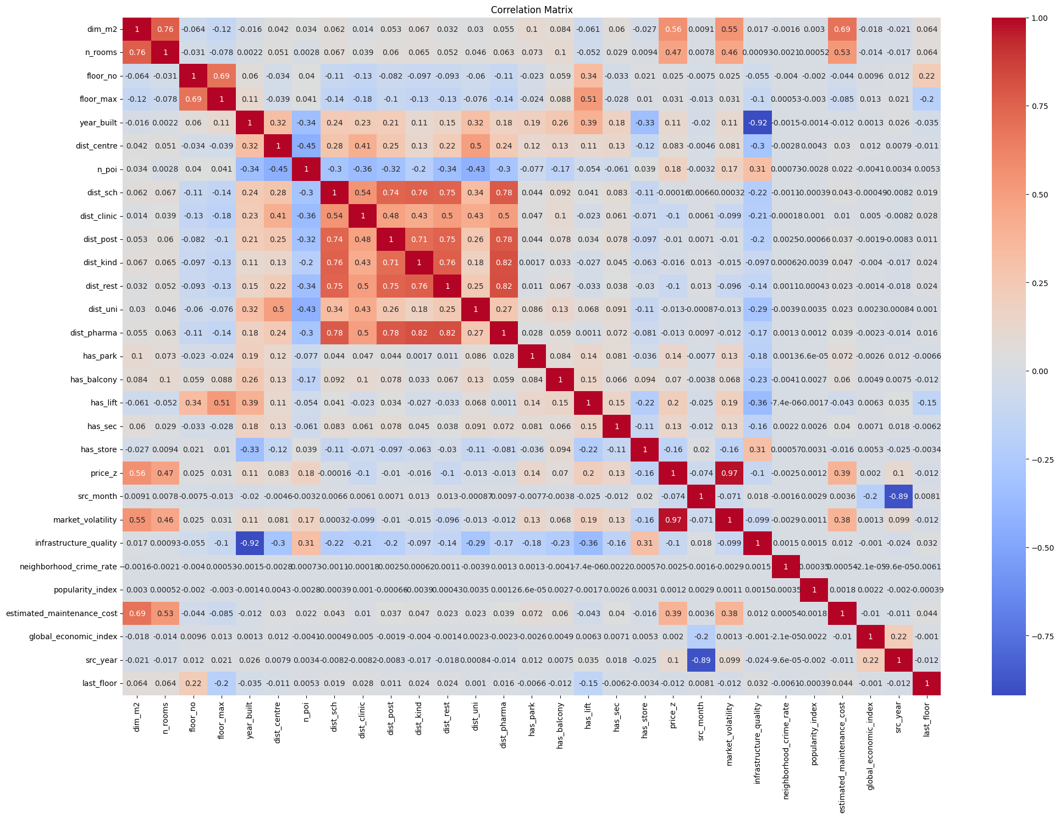
Correlation matrix
majority of variables are not correlated
strongest corr. with target: “market_volatility” (0,97)
distance variables are more correlated

Slide 7
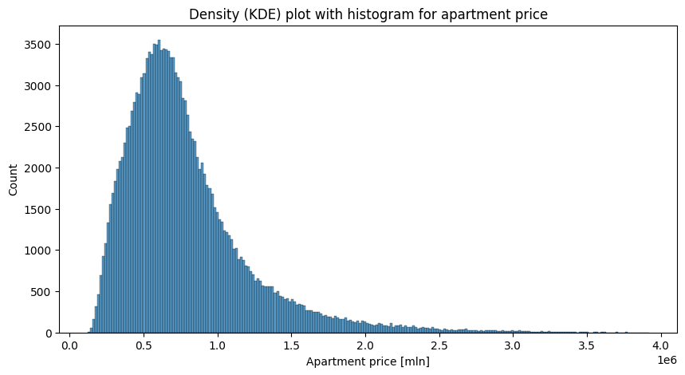
Target variable (price_z)
Characteristics
positively skewed (long right tail)
mean > median
leptokurtic distribution (sharp peak + heavier tails)
high standard error
measure | value
mean | 784 808
median | 690 193
standard error | 430 165
skewness | 1.84
kurtosis | 5.2

Slide 8
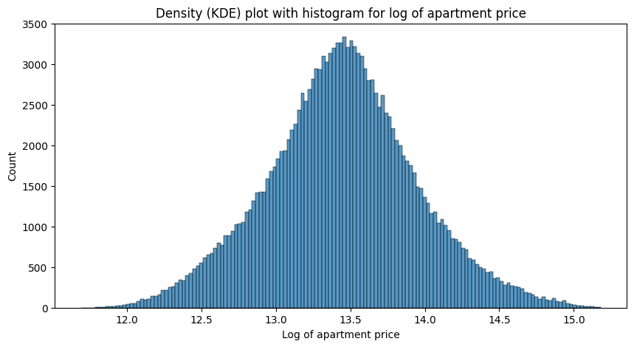
NEW Target variable (log_price)
New characteristics
normal distribution shape
mean ~ median
low standard error
very low values of skewness and kurtosis
measure | value | log value
mean | 784 808 | 13.45
median | 690 193 | 13.44
standard error | 430 165 | 0.5
skewness | 1.84 | 0.06
kurtosis | 5.2 | 0.12

Slide 9
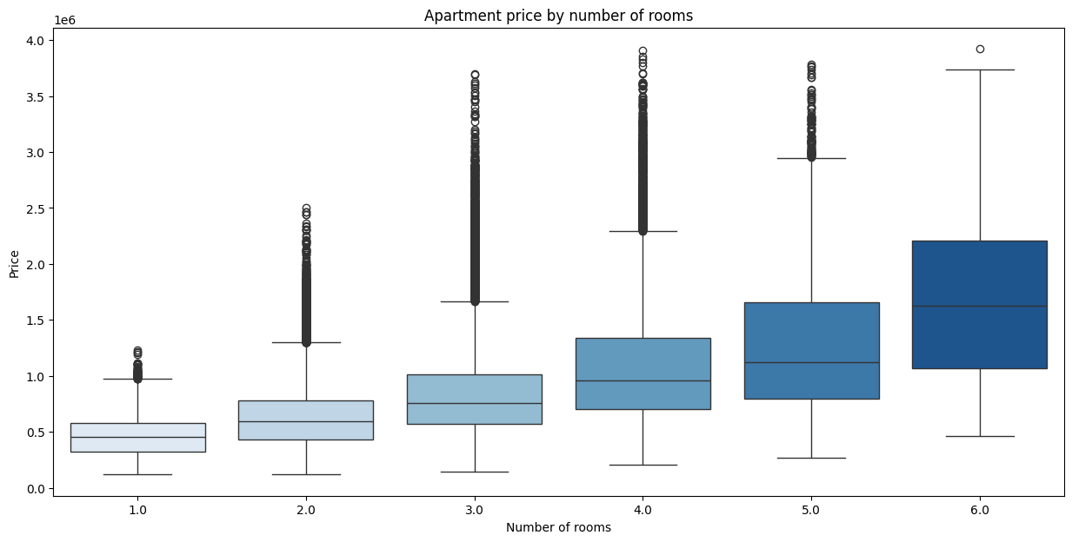
Impact of the number of rooms
apartment prices generally increase with the number of rooms.
price variability grows with more rooms (especially from 4 rooms onward)
outliers are present for all room counts; with many extremely high prices

Slide 10
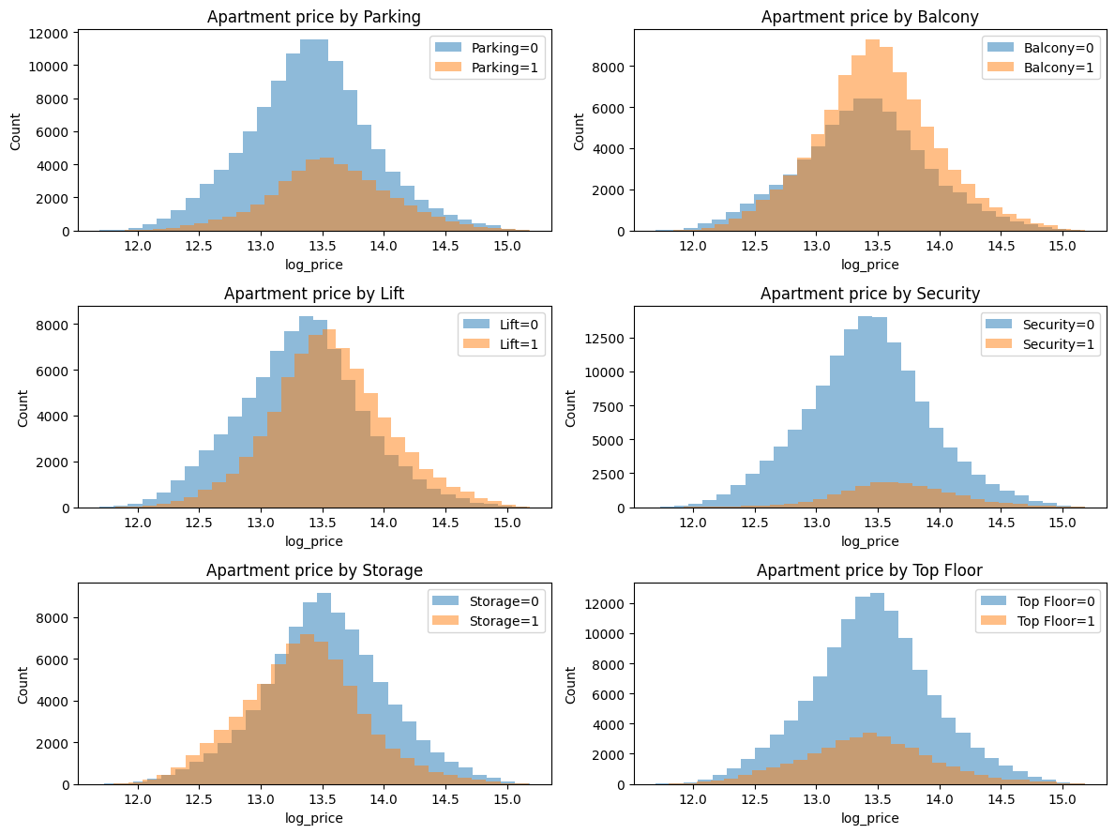
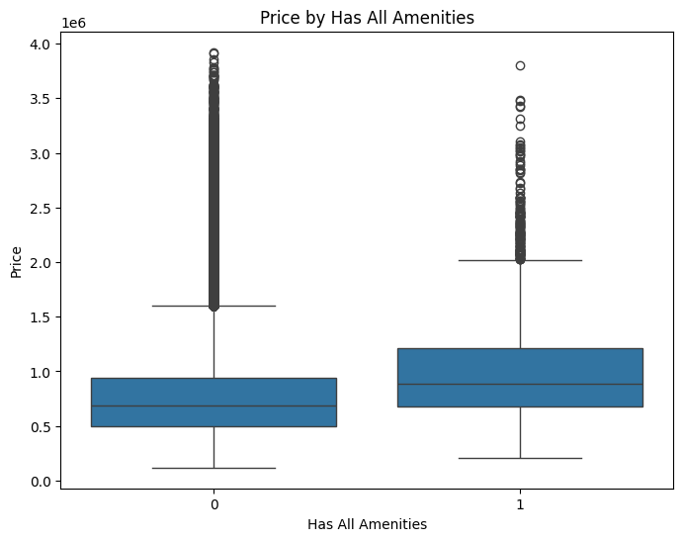
Effect of apartment’s amenities
no significant difference on Parking, Balcony, Top Floor plots
apartments with Lift or Security were slightly more expensive
apartments with Storage were cheaper than without it
apartments with all amenities were more expensive

Slide 11
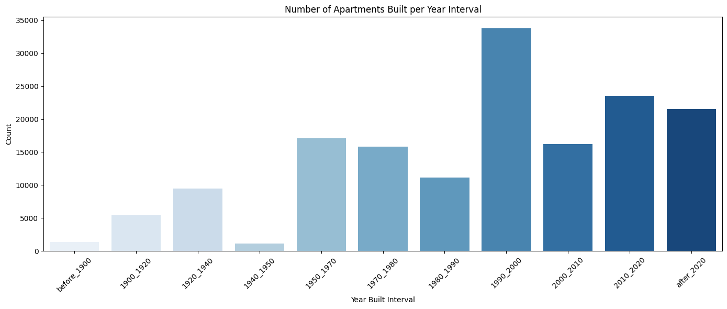
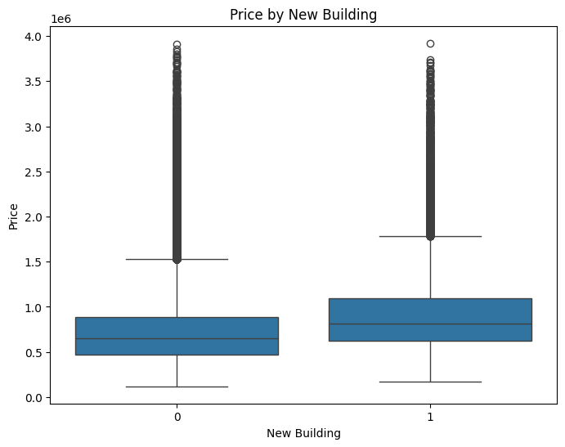
Dive into built years
most apartments were built between 1990-2000
almost no buildings from times of WW2
apartments in new buildings were more expensive

Slide 12
02
FEATURE ENGINEERING

Slide 13
EXAMPLES OF FEATURE ENGINEERING
NEW VARIABLES
ONE-HOT ENCODING
Creating new variables based on existing ones
Coding categorical variables as distinct columns
LOGS
TOP_FLOOR
YEAR_BUILT_CAT
OTHER VARIABLES
Creating new logarithms of right-skewed variables
Shows if apartment is on the top floor of building
Aggregates built year into intervals
Changing other categorical variables like ”obj_type” or “own_type”

Slide 14
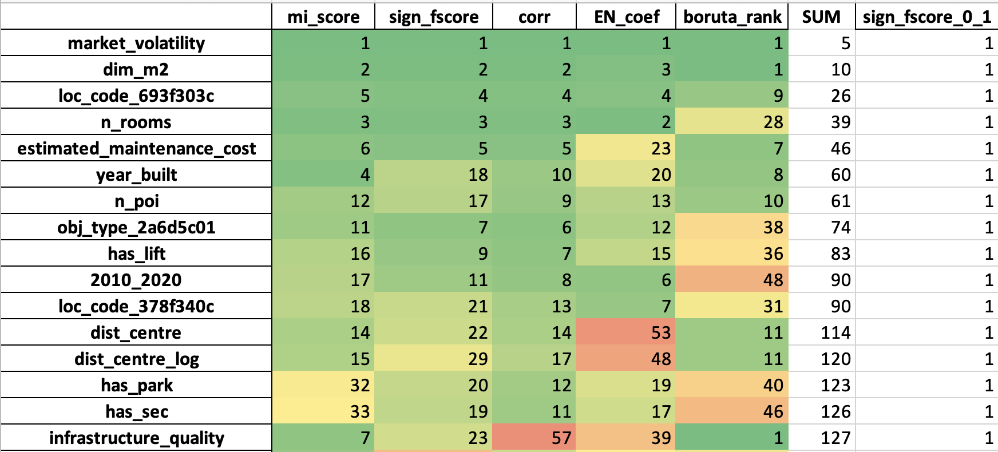
DIVE INTO FEATURES
We decided to perform feature importance analysis using:
mutual information (mi_score)
F-score
Pearson correlation
ElasticNet
Boruta
Then we assigned the ranks for each result and created ranking of the best variables for better data understanding

Slide 15
03
MODELLING

Slide 16
TRAIN DATASET SPLIT
The model has enough data to learn effectively
70%
TRAIN
training
15%
VALIDATION
tuning parameters
15%
TEST
final evaluation
Evaluation is fair and unbiased
Model is more likely to generalize well to new, unseen data.

Slide 17
ML MODELS
O
L1
L2
L3
OLS
Lasso
Ridge
Elastic Net
No Regularization
Baseline for Comparison
Fast and Interpretable
L1 Regularization
Performs Feature Selection
Sparse Solutions
L2 Regularization
Shrinks Coefficients
Handles Multicollinearity
Mix of L1 and L2
Balances Shrinking and Sparsity
Useful with Correlated Features

Slide 18
MODELLING STEPS
GridSearchCV Set
5-fold cross validation
Grid Search for Hyperparameter Tuning
Training model on train data and tuning hyperparameters
Train and Tune the Model
Reviewing results and choosing the very best model
Evaluation and Choice the Best Model

Slide 19
MODELS’ PERFORMANCE
model | RMSE on validation
OLS | 103 926
Lasso | 93 509
Ridge | 93 450
Elastic Net | 93 508
OLS model performed the worst
3 other models had really close results, but we chose Ridge regression as our final one
RMSE on test
96 196

Slide 20
FINAL RIDGE MODEL PARAMETERS
0.00001
alpha
Auto
Solver
True
Intercept
False
only positive

Slide 21
THANKS!
DO YOU HAVE ANY QUESTIONS?

